Slide 1

Developing XML Web Services and Server Components with Visual C# .NET
PART V
COMPONENT SERVICES
Amir Ahani
Microsoft Certified Solution Developer (MCSD .NET)
Microsoft Certified Application Developer (MCAD)
Microsoft Embedded Partner (www.mswep.com)

Slide 2

MSMQ
Queued Components

Slide 3
DCOM Time-Dependent
Distributed Application
Client
Order
Shipping
Order
Shipping
Transaction scope

Slide 4
DCOM Time-dependent
Distributed Applications
Synchronous procedure call
Results via parameters and return codes
Simple to write and understand
Component lifetimes overlap
Fails if any component is unavailable
Sometimes the only available solution

Slide 5
Messaging Application
Client
Transaction 1
Transaction 3
MSMQ
Order
Shipping
Ship
Order

Slide 6
Why Use Messaging?
Orders can be submitted without access to remote resources
  End users often unaware of server slowdown or failure
  Remove work from critical path
  ~40% of new computers sold are mobile
Full control of scheduling
  Good match for operational needs
  Non-critical work can be amortized

Slide 7
Scheduling Convenience
Not all processing needs to be done as a single transaction
  Server processes are queue-driven
  Processes are configured for throughput
  No “resource shortage” responses
Server object lifetime is an important scalability factor
  Server object lifetime is independent of think time and communications

Slide 8
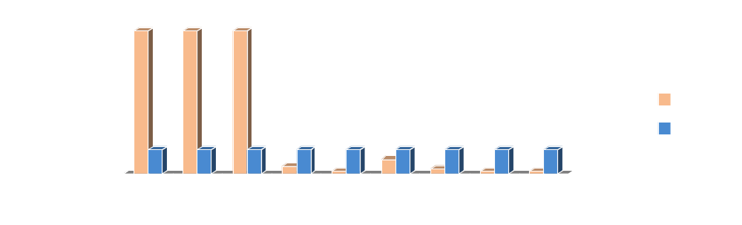
Scheduling Example
Given 1,000,000 transactions/day
  Order needs to be up 24x7 and handle peak load between 9am and 12pm (90% of orders taken between 9-12)
  Ship only needs to be up 20 hrs day

Slide 9
No Loss in Reliability
MSMQ transacted queues deliver messages exactly once, without data loss or duplication
MSMQ transacted operations undone by transaction abort
Server can be terminated without data loss because of transaction guarantees

Slide 10
Queued Components
COM+ feature to ease development of message based systems
  Transport details removed from application
  Applications use their own interfaces
  Same binary component can be activated direct or queued
  Multi-threaded server

Slide 11
Queued Components
Order Entry
Shipping
S = GetObject
Listener
S.num = 1234
S.custid = 789
Player
S.Line 10, widget
MSMQ
num property
custid property
Recorder
Line method

Slide 12
Interface Design for
Time Independence
Requestor may end before server starts
(no overlap)
One-way messaging
Method parameters are in-only (By Value, no function return values)
No application-significant HRESULT
Expect no synchronous result

Slide 13
How do I get output?
Pessimist: Client requires response every time, like RPC
Optimist: Trust the infrastructure, don’t ask for a response
Less paranoid: generate response messages selectively
  Exception protocols

Slide 14
Use of a Response Object
(COM+ QC sample)
Transaction 1
Transaction 2
Client
Order
Shipping
Order
Transaction 3
Notify
Shipping

Slide 15

Margie’s Travel
Order
Credit
Card
Client
Travel
Db
Status

Slide 16
Component activation with the “new” Moniker
“new” does what many people wish the “clsid” moniker would do
When alone, creates an object instance
  like CoCreateInstance(Ex)
Uses existing moniker helper
  Set obj = GetObject(“new:ProgID”)
  CoGetObject(L”new:ProgID”, pBindOpts2, iid, (void **) &ppvobj);

Slide 17
QC Component activation with the “queue” moniker
Composes with “new” moniker
  Set obj = GetObject(“queue:/new:Ship”)
Carries selected MSMQ attributes, if you require them
  Set obj = GetObject(“queue: ComputerName=Denver,
  Priority=3 / new:Ship”)
Explicit attributes normally not required

Slide 18
Handling Errors
Messages causing repeated aborts are moved to a “poison message” queue
  Fix problem & move messages back
  Gather diagnostic info & delete
  Generate compensating transaction
Often matches business scenarios
  Consider how banks handle bad checks
An alternative to long-lock hold times

Slide 19
Queuing Exception Class
Must support IPlaybackControl…
  [ local, pointer_default(unique),
  uuid(…) ]
  interfaceIPlaybackControl : IUnknown
  {
  HRESULT FinalClientRetry();
  HRESULT FinalServerRetry();
  }
…in addition to queued interfaces

Slide 20
Windows 2000 Beta 3 QC Features
Pass QC interfaces to other QCs
Non-transactional queues
MSMQ properties via queue moniker
QUEUEABLE interface attribute in IDL
Set Complete method attribute
Admin SDK support

